Slide 1
Project Overview

Slide 2
Experiment 1

Slide 3
Research Question
How does a diagnostic system based on the human cognitive processes compare to a baseline?

Slide 4
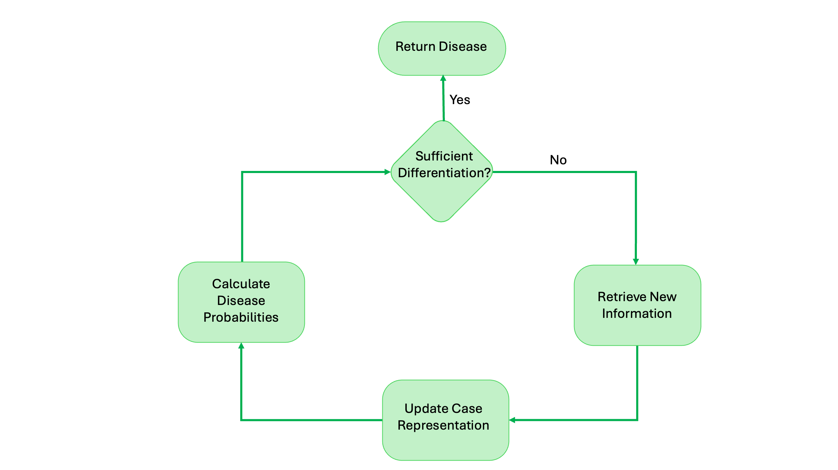
Interviewed an Expert
Our analysis of the interview resulted in the following framework:

Slide 5
Experiment 2

Slide 6
Research Question
What is the most accurate information collection strategy for a computer-based diagnostic system?

Slide 7
Environment
LLM
Query Strategy
Collected
Information
“Diagnosis”
Query
Private
Randomly Generated
Answer

Slide 8
Information Collection Strategies
1. Hypothesis-driven search
Collect new information
Update your Hypothesis
No
Satisficing Hypothesis?
Yes
Return diagnosis

Slide 9
Information Collection Strategies
2. Knowledge-driven search
Collect new information
Recognize patterns
No
Satisficing information?
Yes
Return diagnosis

Slide 10
Information Collection Strategies
3. Gut Feeling
Collect new information
Alarm
Current Sense?
Reassurance
Return diagnosis

Slide 11
Information Collection Strategies
4. Channel-based
Conduct patient interview
Physical Exam
No
Confident in diagnosis?
Yes
Return diagnosis

Slide 12
Information Collection Strategies
5. Sequence-based
Initialization of diagnosis
Refinement of diagnosis
Defining the final diagnosis

